Slide 1
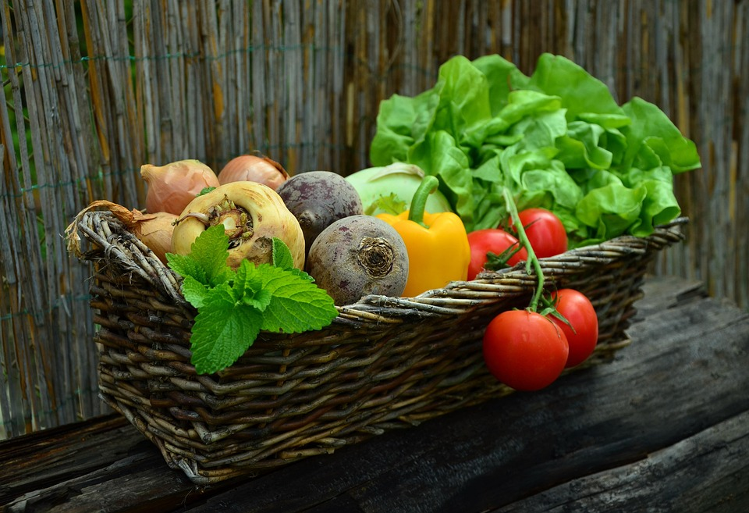

IMPORTANCE OF HEALTHY FOOD
This Photo by Unknown Author is licensed under CC BY

